Slide 1
Improving Deep Neural Nets in the perspective of Drop Outs
Madhu Rajesh
26-06-2020

Slide 2
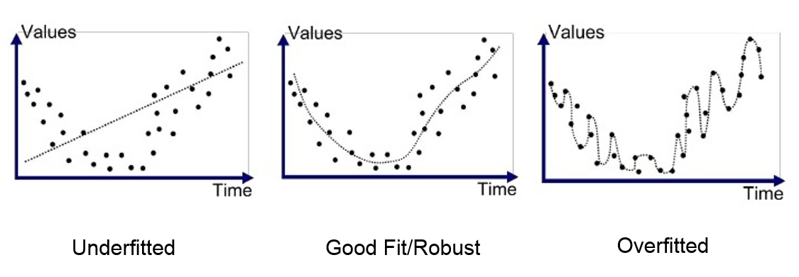
Overfitting Vs Underfitting
Bias- When model cannot understand the concept
Variance – When learning algorithm over reacts to small changes(Noise)
Overfit:
Fitting the data too well - too much reliance on the training data
Underfit:
Learning too little of the concept-a failure to learn the relationships in the training data

Slide 3
Regularization
Increase the Training set – Data augmentation
L1, L2 – Additional parameters to Loss function
Early stopping
Dropout

Slide 4
Standard Dropout Methods
To prevent overfitting in the training phase, neurons are omitted at random
Introduced in a dense (or fully connected) network, for each layer we give a probability p of dropout
At each iteration, each neuron has a probability p of being omitted
Suggested, p=0.2 on the input layer and p=0.5 on the hidden layers.

Slide 5
DropConnect
Does not apply a dropout directly on the neurons but on the weights and bias linking these neurons.
Mask is not applied on the neuron vector of a layer but on the matrix of weights connecting the layer to the previous one.
Testing phase, a stochastic approach - Gaussian approximation of the dropConnect and by randomly drawing samples

Slide 6
Standout
The probability p of omission of the neuron is not constant on the layer. It is adaptative according to the value of the weights.
greater the weight, the greater the probability that the neuron will be omitted.

Slide 7
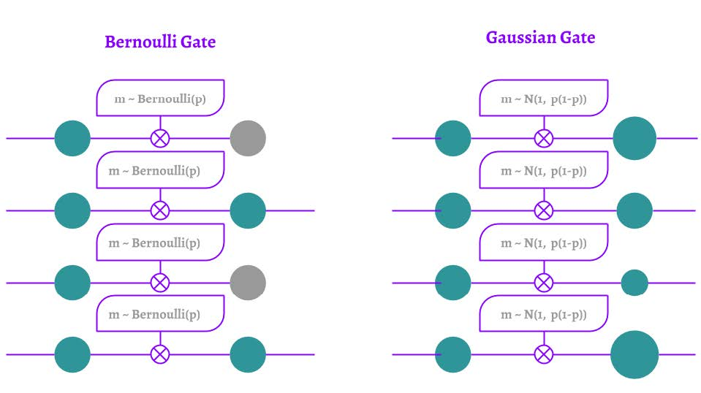
Gaussian Dropout
Bayesian Mask ; Random variables following gaussian distribution.
All the neurons are exposed at each iteration and for each training sample unlike usual dropout
Gaussian Mask simulates the dropout by randomly weighting their predictive capacity by keeping all neurons active at each iteration.
Testing phase, no modification to be made compared to a model without dropout

Slide 8
Pooling Dropout
Randomly omits pixels on an image then almost no information is removed.
The omitted pixels are nearly the same as their surroundings
It applies Bernoulli’s mask directly to the Max Pooling Layer before performing the pooling operation.
Average Pooling Layer, we could apply a dropout in the same way during the training phase.
Test phase, there would be no change since it is already a weighted average

Slide 9
Spatial Dropout
Dropout per feature map
Training phase, a Bernoulli mask is applied per feature map with a probability of omission p.
Testing phase, there is no dropout but a weighting by the probability of presence 1-p .

Slide 10
Cutout
Max-Drop
Instead of applying Bernoulli masks per feature map, they can be applied in areas.
Mixture of Pooling Dropout and Gaussian Dropout.
The dropout is performed on the Max Pooling Layer but with a Bayesian approach.

Slide 11
RNNDrop
A Bernoulli mask is applied only to the hidden cell states.
This is called the per-sequence sampling of dropout, each iteration a random mask is created.
Then from one sequence to another, this mask remains unchanged.
The dropped elements remain dropped and the present elements remain present.

Slide 12
Recurrent Dropout
The cell state is left untouched.
A dropout is only applied to the part which updates the cell state.
At each iteration, Bernoulli’s mask makes some elements no longer contribute to the long term memory.

Slide 13
Variational RNN dropout
Sequence-based dropout before the internal gates.
This causes a dropout on the different points of the LSTM.

Slide 14
Thank you

